Slide 1
Week 1
Introduction to Database Ts. Chng Chern Wei

Slide 2

What is Data?
A collection of raw facts and figures
Raw material that can be processed by any computing machine
Data can be represented in the form of numbers and words which can be stored in computer’s language.

Slide 3
What is Information?
Systematic and meaningful form of data
Knowledge acquired through study or experience.
Information helps human beings in their decision making

Slide 4
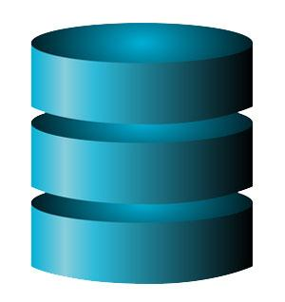
What is a Database?
General: A database is any collection of related data, designed to meet the information needs of an organization
Restrictive/ Specifically: A database is a persistent, logically coherent collection of inherently meaningful data, relevant to some aspects of the real world.

Slide 5

What is Database?
A database is one of the essential components for many applications and is used for storing a series of data in a single set.
In other words, it is a group/package of information that is put in order so that it can be easily accessed, manage, and update.

Slide 6
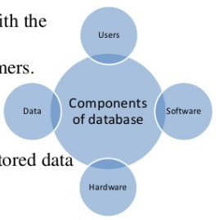
Components of Database System
Users - People who interact with the database
Application Programmers
End Users
Data Administrators
Software - Lies between the stored data and the users
DBMS
Application Software
User Interface

Slide 7
Components of Database System
Hardware - Physical device on which database resides
Computers, Disk Drives, Printers, Cables etc
Data - numbers, characters, pictures

Slide 8
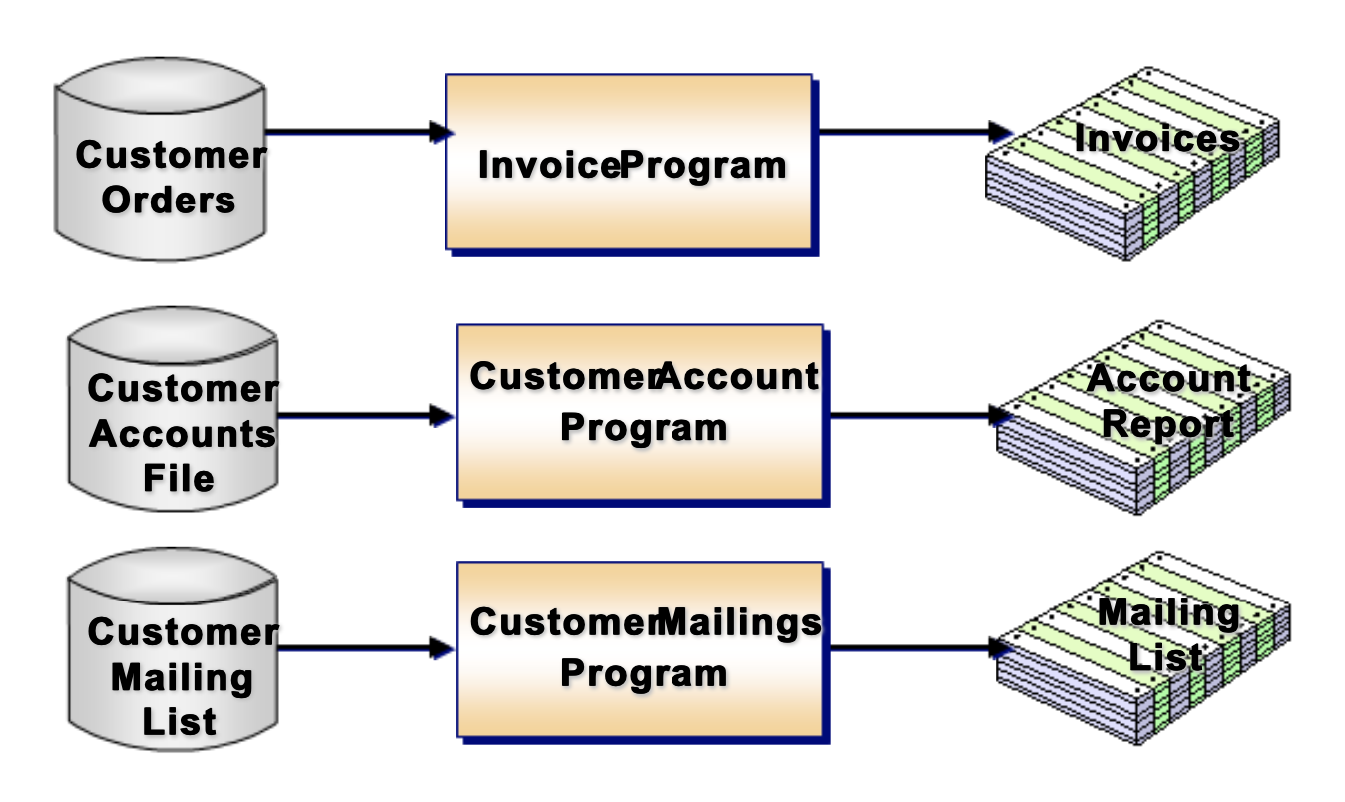
Traditional File-Based System
A collection of application programs that perform services for the end users such as the production of reports. Each program defines and manages its own data.

Slide 9
Data Redundancy - inconsistency
Customer Order File
Invoice number
Customer account number
Customer name, address, city, state, postcode
Order Date
Product Code, Product name, price, unit
Customer Account File
Account number
Customer name, mailing address, city, state, postcode
Customer Mailing List File
Customer name, mailing address, city, state, postcode

Slide 10
File-Based Systems - Limitation
Duplication of data (redundancy)
Loss of data integrity - uncertainty of the correct version of data and no consistency.
Data dependence - application program defines the data
Incompatibility of file formats (isolation)
Fixed queries of application program.
Data Security

Slide 11
Database Management System (DBMS)

Slide 12
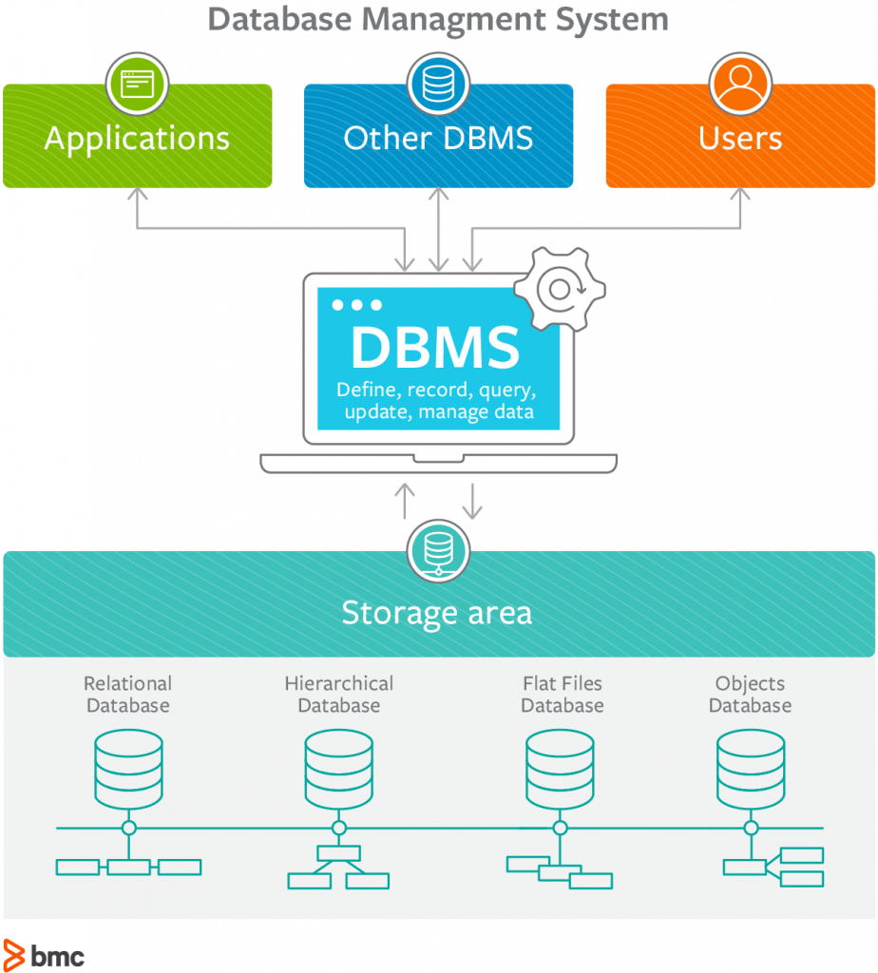
What is a Database Management System?
A DataBase Management System (DBMS) is a collection of programs that enables users to organize (create, retrieve, update, and manage) data in a database information that is both convenient and efficient.

Slide 13
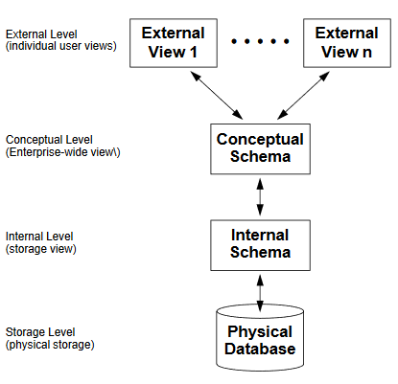
The way users recognize the data is called the External Level.
The way the DBMS and the operating system distinguish the data is the Internal Level, where the data is stored using the data structures and file.
The Conceptual Level offers both the mapping and the desired independence between the external and internal levels.

Slide 14
What advantages a DBMS offer?
Database management systems provide several functions in addition to simple file management:
allow concurrency
control security
maintain data integrity
provide for backup and recovery
control redundancy
allow data independence
provide non-procedural query language
perform automatic query optimization

Slide 15
DBMS: Allow Concurrency
Concurrency control is the procedure in DBMS for managing simultaneous operations without conflicting with each other.
Concurrency control is used to address such conflicts which mostly occur with a multi-user system. It helps you to make sure that database transactions are performed concurrently without violating the data integrity of respective databases. Example, buy movie ticket online.

Slide 16
DBMS: Control Security
Availability loss − Availability loss refers to non-availability of database objects by legitimate users.
Integrity loss − Integrity loss occurs when unacceptable operations are performed upon the database either accidentally or maliciously leads to corrupted data.
Confidentiality loss − Confidentiality loss occurs due to unauthorized or unintentional disclosure of confidential information. It may result in illegal actions, security threats and loss in public confidence.

Slide 17
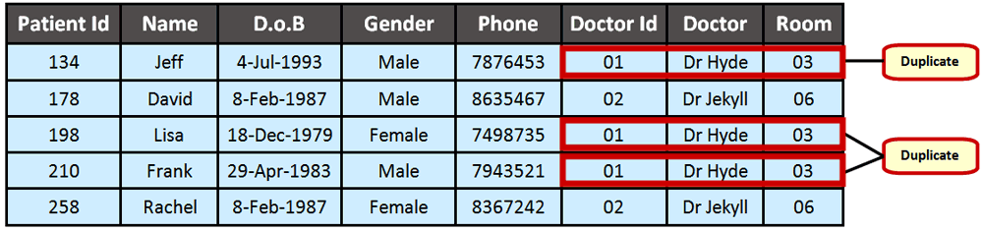
DBMS: Control Redundancy
Data redundancy is a condition created within a database or data storage technology in which the same piece of data is held in two separate places.
This can mean two different fields within a single database, or two different spots in multiple software environments or platforms.

Slide 18
DBMS: Allow Data Independence
If a database system is not multi-layered, then it becomes difficult to make any changes in the database system.
A database system normally contains a lot of data in addition to users’ data. It stores data about data, known as metadata, to locate and retrieve data easily.
Metadata itself follows a layered architecture, so that when we change data at one layer, it does not affect the data at another level. This data is independent but mapped to each other.

Slide 19
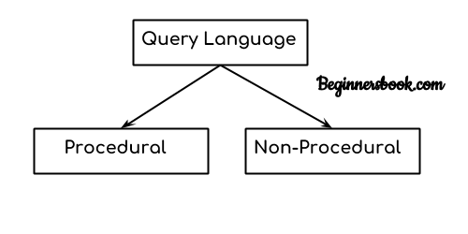
DBMS: Provide non-procedural query language
In simple words, a Language which is used to store and retrieve data from database is known as query language.
There are two types of query language:
Procedural Query language
Non-procedural query language

Slide 20
1. Procedural Query language:
In procedural query language, user instructs the system to perform a series of operations to produce the desired results. Here users tells what data to be retrieved from database and how to retrieve it.
2. Non-procedural query language:
In Non-procedural query language, user instructs the system to produce the desired result without telling the step by step process. Here users tells what data to be retrieved from database but doesn’t tell how to retrieve it.

Slide 21
DBMS Users

Slide 22
Where is DBMS being used?
Airlines: reservations, schedules, etc
Telecom: calls made, customer details, network usage, etc
Universities: course registration, results, grades, etc
Sales: products, purchases, customers, ecommerce etc
Banking: all transactions etc

Slide 23




DBMS Example
Oracle
MySQL
Microsoft SQL Server
Microsoft Access
etc

Slide 24
Who Interacts with a DBMS?
Many different individuals are involved with a database management system over its life:
systems analysts
database designers
database administrators (DBA)
application developers
users

Slide 25
System Analyst
Implements computer system requirements by defining and analyzing system problems; designing and testing standards and solutions.
Identify application problem by communicating with clients; evaluating procedures and processes.
Develops solution by preparing and evaluating alternative workflow solutions.
Controls solution by establishing specifications and coordinating production with programmers.

Slide 26
Database Designer
Responsible for defining the detailed database design, including tables, indexes, views, constraints, triggers, stored procedures, and other database-specific constructs needed to store, retrieve, and delete persistent objects.

Slide 27
Application Developer
Responsible for Creating and implementing the source code of new applications and data gathering before development of a database.
Database Developer
Database developers create management methods and systems to access information stored in databases efficiently. They design, develop, test, implement and maintain new and existing databases.

Slide 28
Database Administrator (DBA)
A specialized computer systems administrator who maintains a successful database environment by directing or performing all related activities to keep the data secure.
The top responsibility of a DBA professional is to maintain data integrity. This means the DBA will ensure that data is secure from unauthorized access but is available to users.

Slide 29
Q&A?

Slide 30
Thank You!

